Slide 1
Chapter IX
Lighting
All class materials including this PowerPoint file are available at
https://github.com/medialab-ku/openGLESbook

Slide 2
Phong Lighting Model
Lighting or illumination refers to the technique that handles the interaction between lights and objects.
The most popular lighting method is based on the Phong model. It is widely adopted in commercial games and lays foundations of various advanced lighting techniques.
The Phong model is composed of four terms:
  diffuse
  specular
  ambient
  emissive
9-<number>

Slide 3
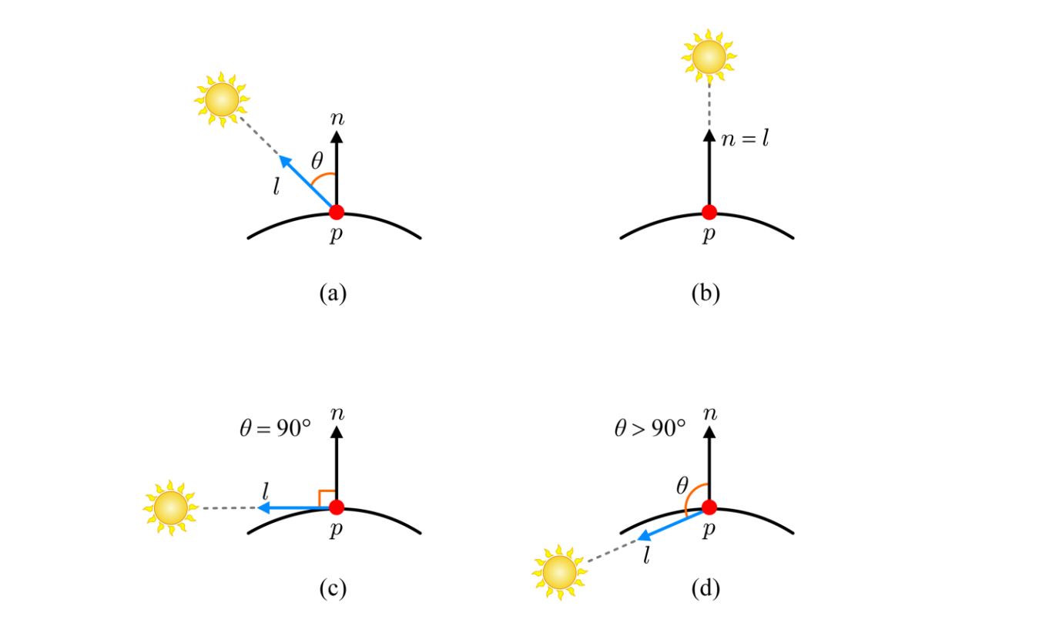
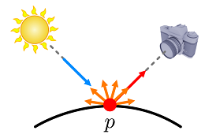
Phong Lighting Model - Diffuse Term
There are various light types. Let’s take the simplest, the directional light source, such as the sun, which is quite strong and located far from the scene, making all objects in the scene receive the sunlight along a universal direction.
The diffuse term is based on Lambert’s law. Reflections from ideally diffuse surfaces (Lambertian surfaces) are scattered with equal intensity in all directions.
So, the amount of perceived reflection is independent of the view direction, and is just proportional to the amount of incoming light.
The light vector (l) is toward the light source for computational efficiency.
9-<number>

Slide 4



Phong Lighting Model - Diffuse Term (cont’d)
Suppose a white light (1,1,1). If an object lit by the light appears red, it means that the object reflects R only but absorbs G and B. We can easily implement this kind of filtering through material parameter, i.e., if it is (1,0,0), then (1,1,1)⊗(1,0,0)=(1,0,0) where ⊗ is component-wise multiplication.
The diffuse term:
In general, the texture provides m_{d}.
R
G
B
R
G
B
intensity 1
1
1
intensity 1
0.5
1
1×1=1
1×0=0
1×0=0
1×0.5=0.5
0.5×1=0.5
1×0=0
(1,0,0)
(0.5,1,0)
9-<number>

Slide 5
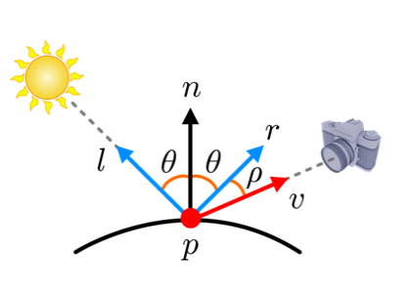
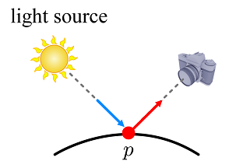

Phong Lighting Model - Specular Term
The specular term is used to make a surface look shiny via highlights, and it requires reflection vector (r) and view vector (v) in addition to light vector (l).
Computing the reflection vector
9-<number>

Slide 6
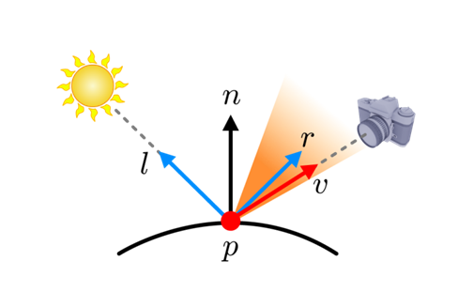




Phong Lighting Model - Specular Term (cont’d)
Whereas the diffuse term is view-independent, the specular term is highly view-dependent.
  For a perfectly shiny surface, the highlight at p is visible only when ρ equals 0.
  For a surface that is not perfectly shiny, the maximum highlight occurs when ρ equals 0, but falls off sharply as ρ increases.
  The rapid fall-off of highlights is often approximated by (r⋅v)^{sh}, where sh denotes shininess.
The specular term:
Unlike m_{d}, m_{s} is usually a gray-scale value
  rather than an RGB color. It enables the
  highlight on the surface to end up being
  the color of the light source.
  cosρ
  cos²ρ
  cos⁶⁴ρ
9-<number>

Slide 7
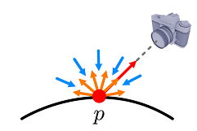

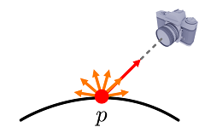

Phong Lighting Model – Ambient and Emissive Terms
The ambient light describes the light reflected from the various objects in the scene, i.e., it accounts for indirect lighting.
As the ambient light has bounced around so much in the scene, it arrives at a surface point from all directions, and reflections from the surface point are also scattered with equal intensity in all directions.
The last term of the Phong model is the emissive term m_{e} that describes the amount of light emitted by a surface itself.
9-<number>

Slide 8
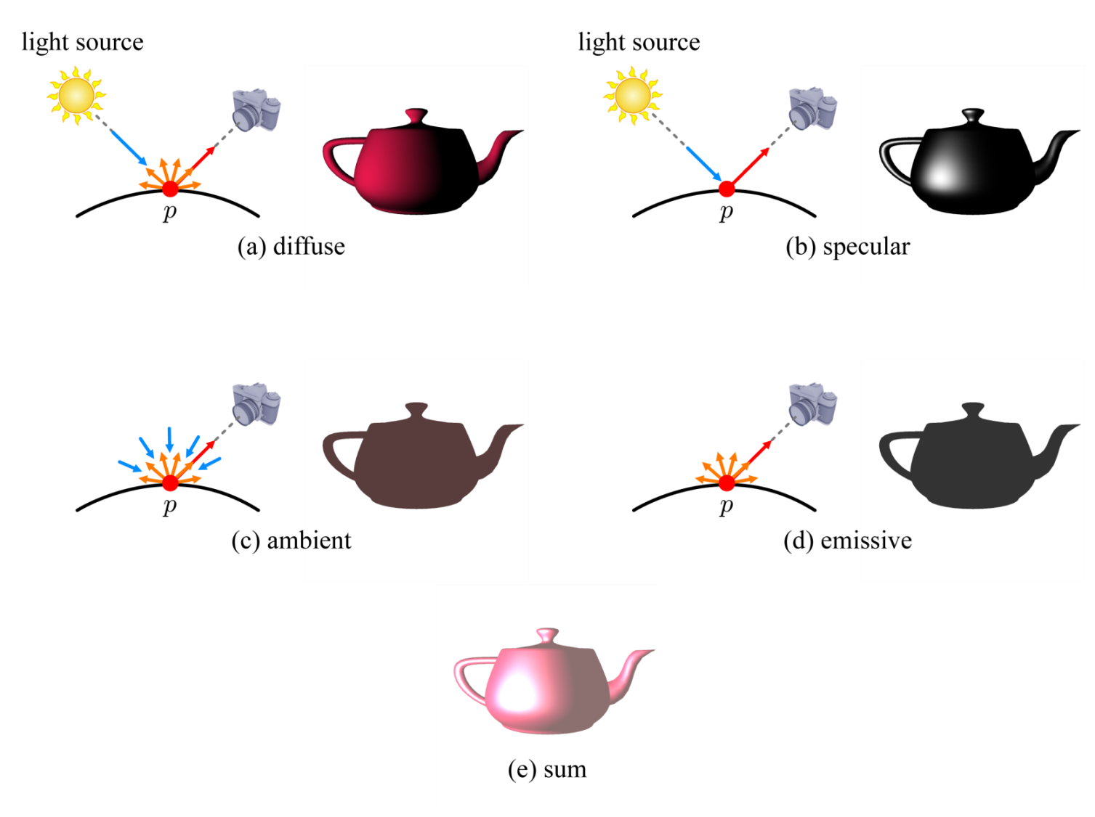
Phong Lighting Model
The Phong model sums the four terms!!
9-<number>

Slide 9
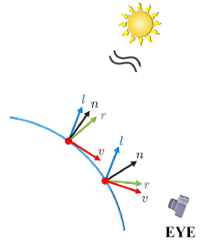
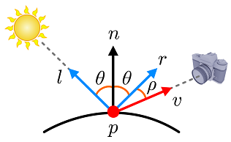
Per-fragment Lighting
Consider two points on an object's surface, each of which makes up a distinct fragment. The fragment shader computes lighting using l, n, r, and v.
  Since we assume a directional light, l is constant for all surface points. It is provided for the fragment shader as a uniform.
  In contrast, n, r, and v vary across the object's surface. A distinct pair of n and v is given to each execution of the fragment shader, which then computes r, which equals 2n(n·l)-l.
9-<number>

Slide 10
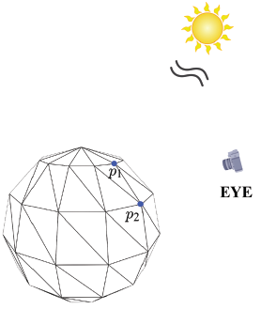
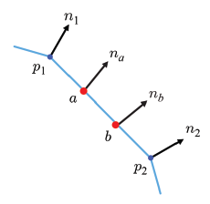
Per-fragment Lighting (cont’d)
Because l is a world-space vector, n should also be defined in the world space. For this, the vertex shader world-transforms the object-space normal of each vertex and passes the world-space normal to the rasterizer. The rasterizer interpolates the vertex normals to provide n for each fragment.
To a and b, each of which is assumed to make up a distinct fragment, the rasterizer assigns normals, n_{a} and n_{b}, by interpolating n₁ and n₂.
9-<number>

Slide 11
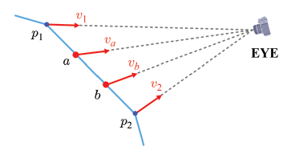
Per-fragment Lighting (cont’d)
For the fragments, a and b, we also need world-space view vectors denoted by v_{a} and v_{b}, respectively. For this, the vertex shader transforms the object-space position of each vertex to the world space and connects it to the camera position, EYE, defined in the world space.
The per-vertex world-space view vectors are v₁ and v₂. They are passed to the rasterizer and interpolated to produce v_{a} and v_{b}.
9-<number>

Slide 12
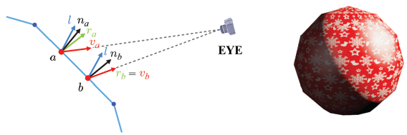
Per-fragment Lighting (cont’d)
Given n and v provided by the rasterizer and l provided as a uniform by the GL program, the fragment shader first computes the reflection vector, i.e., r=2n(n·l)-l, and finally implements the Phong model. Note that l, n, r, and v are all defined in the world space..
9-<number>

Slide 13
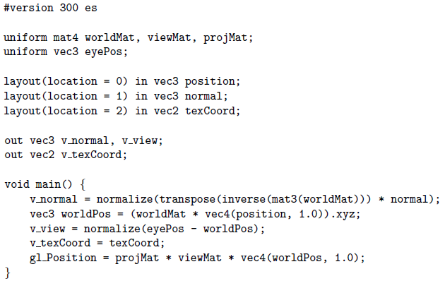
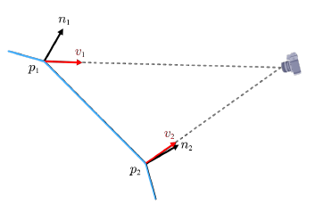
Per-fragment Lighting (cont’d)
The vertex shader.
9-<number>

Slide 14
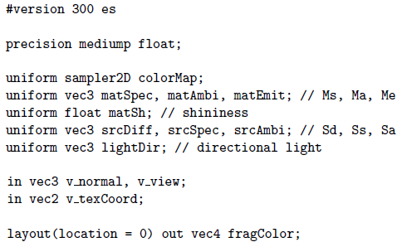
Per-fragment Lighting (cont’d)
The fragment shader.
9-<number>

Slide 15
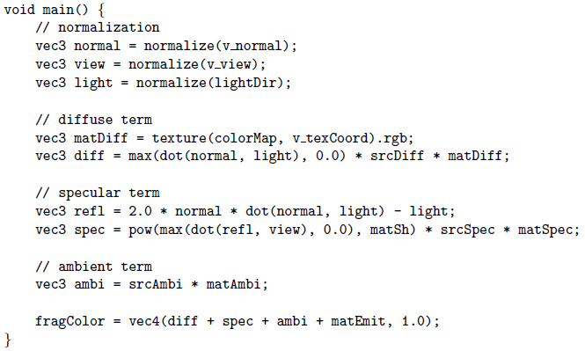
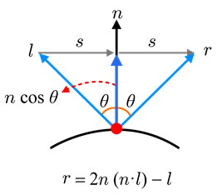
Per-fragment Lighting (cont’d)
The fragment shader.
9-<number>

